Slide 1
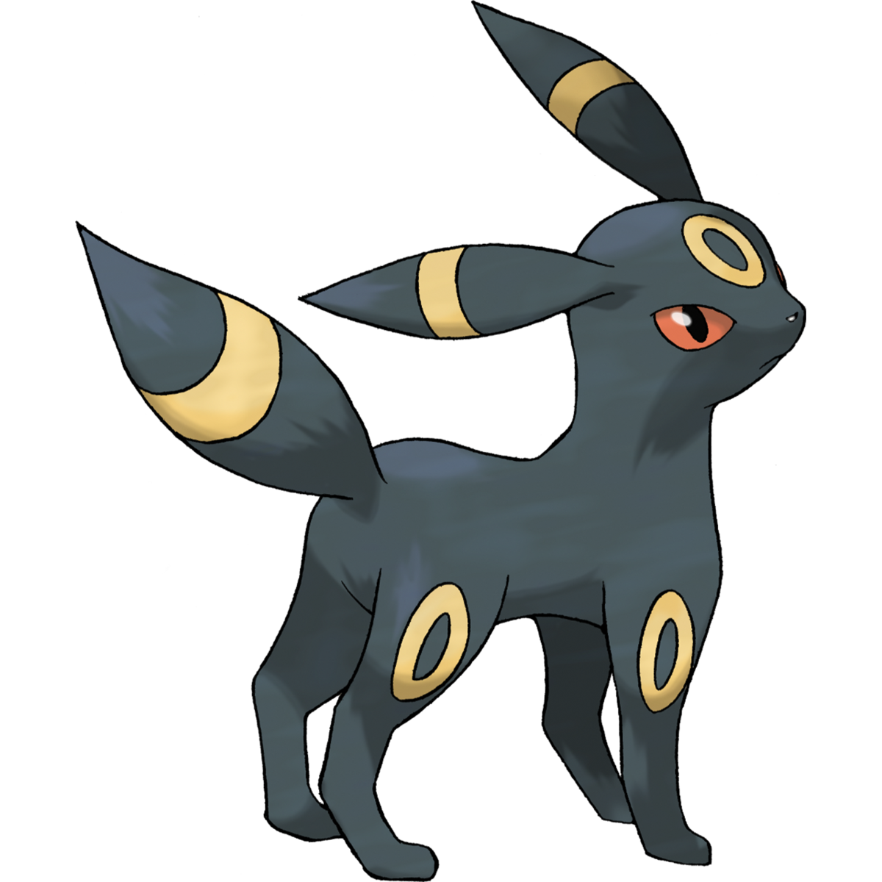
Machine Learning
Pokémon image recognition - Pokédex

Slide 2
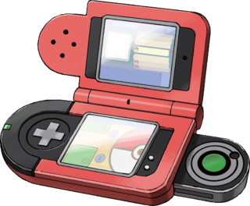

Problem Statement
Our problem is to find the object in the given image. So, for our project we have used Pokémon Dataset.
To identify them we use Object detection and recognition from images to find what Pokémon it is. Here what we are trying to do is we use our machine to identify the Pokémon in the image and give the information about the Pokémon by recognizing it from the image.
We have gathered around 800 image datasets which we use for training, validating and for testing.
So first we are collecting basic information for the model, then we design the required model and algorithm, then we optimize the model to work, after that we train the model, and finally we test the model and use it.
We are inspired by the device called Pokédex in Pokémon animated series, so we decided to recreate it in real life.

Slide 3



Link for dataset
https://www.kaggle.com/lantian773030/pokemonclassification

Slide 4

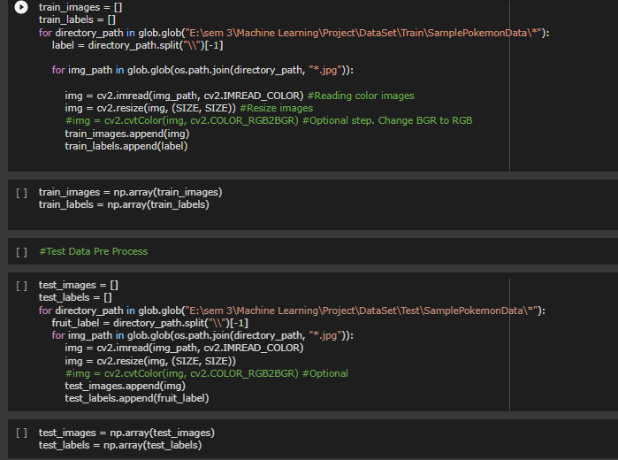
Dataset Pre-processing
Used Open CV for pre processing
The data is initially in the form of images inside the folders
Name of the folders is labels
Data has test and train folders in 20:80 ratio
The data is pre-processed and stored in NumPy array

Slide 5


Feature Extraction
Here we have used the library from skimage import filters for feature extraction
Feature 1 => Pixel Values → Adding pixel values of images to data frame
Feature 2 => Gabor Filter → Gabor, is a linear filter used for texture analysis
Feature 3 => Sobel Filter → It is used to detect edges in an image
Feature 4 => Prewitt Filter → The Prewitt operator is used in image processing, particularly within edge detection algorithms.
Feature 5 => Scharr Filter → This is a filtering method used to identify and highlight gradient edges/features using the 1st derivative

Slide 6

Models Trained
Random Forest
K Nearest Neighbours
Naïve Bayes

Slide 7
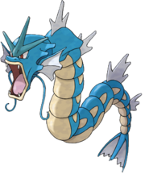
Random Forest
A random forest is a machine learning technique that's used to solve regression and classification problems.
It utilizes ensemble learning, which is a technique that combines many classifiers to provide solutions to complex problems.
A random forest algorithm consists of many decision trees.
( -X- )Spoiler : It has Highest accuracy in Classical ML model in our case

Slide 8
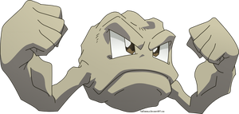
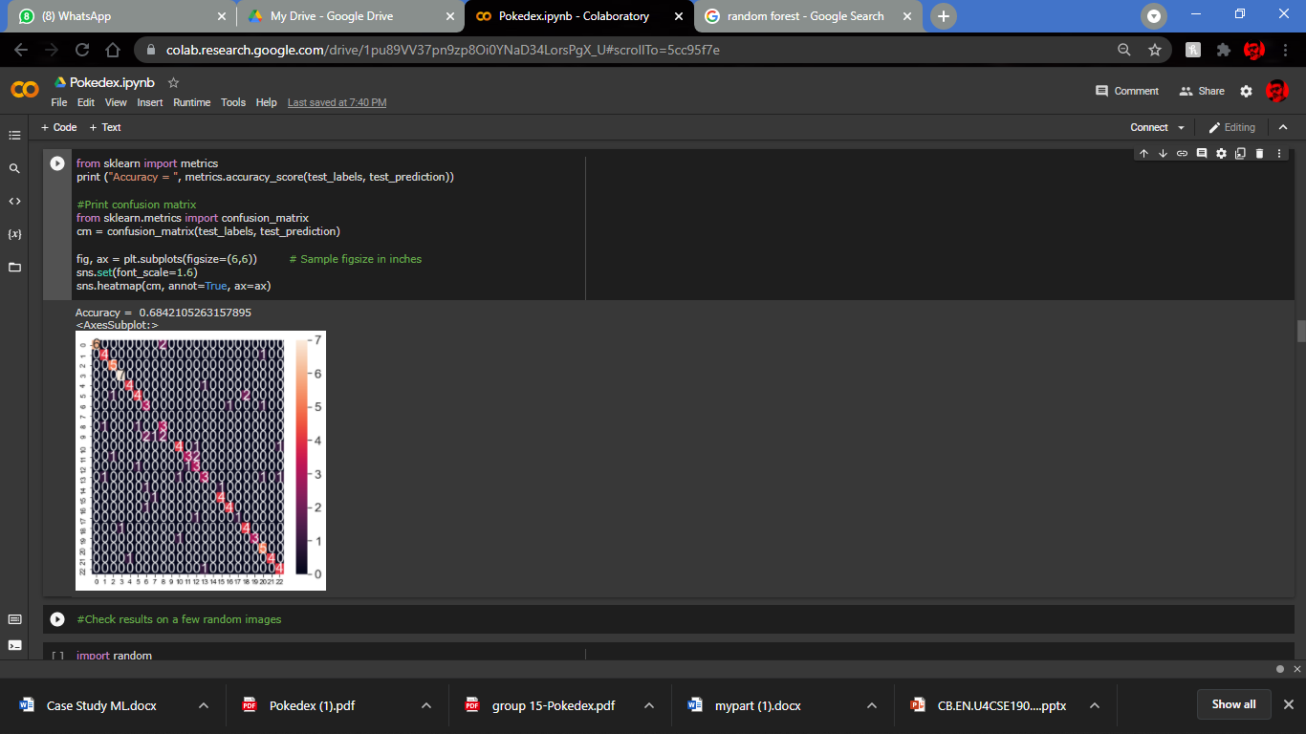
Random Forest
Accuracy:
0.6842105263157895

Slide 9

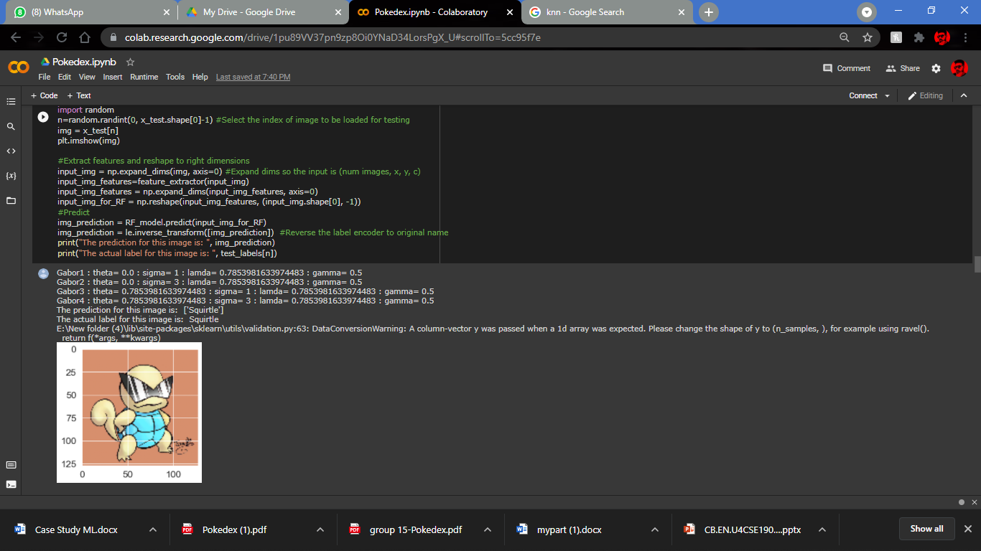
Random Forest (Validation)

Slide 10
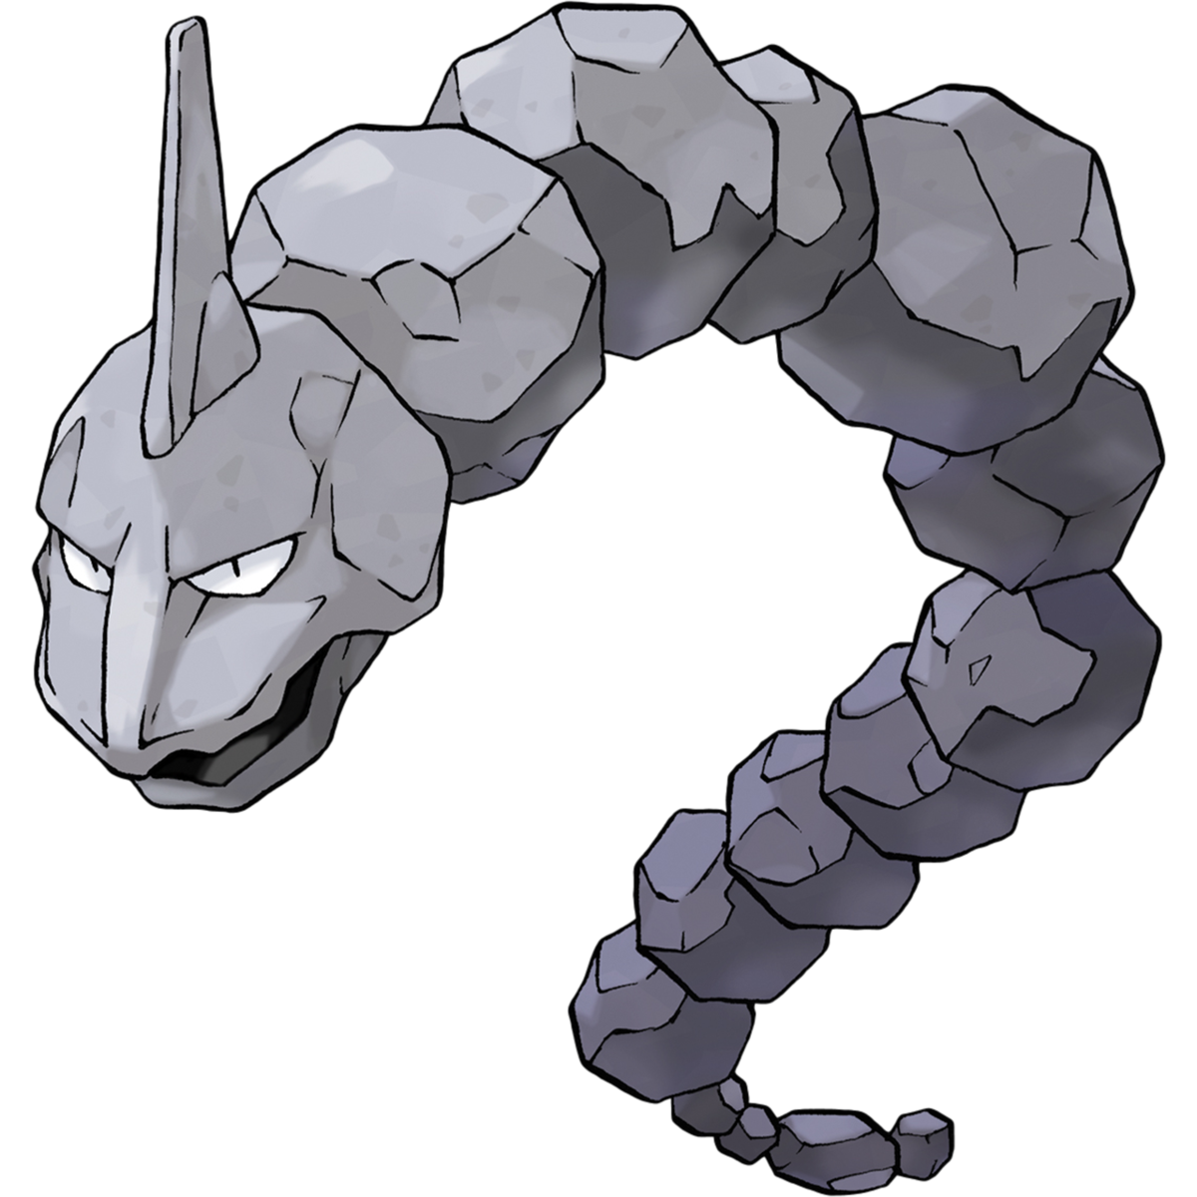
K Nearest Neighbour
Supervised machine learning algorithm that can be used to solve both classification and regression problems
Assumes that similar things exist in close proximity (similar things are near to each other)
KNN captures the idea of similarity (sometimes called distance, proximity, or closeness)
Lazy learning algorithm
Non-parametric learning algorithm

Slide 11
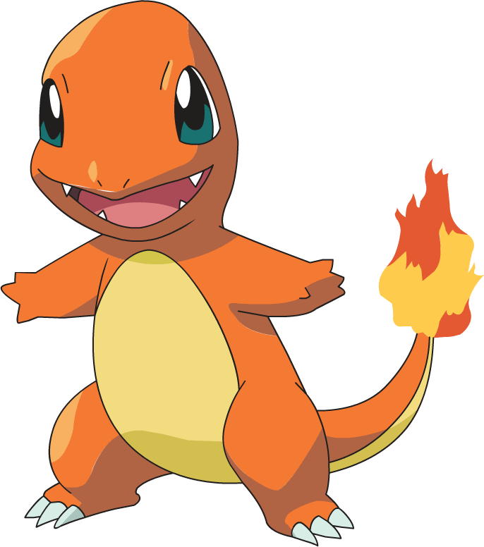
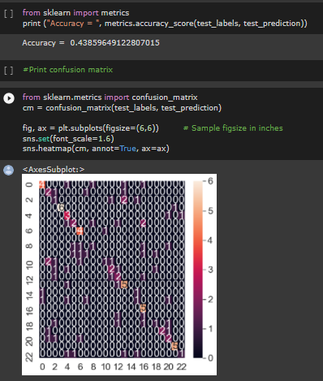
K N N
Accuracy:
0.43859649122807015

Slide 12
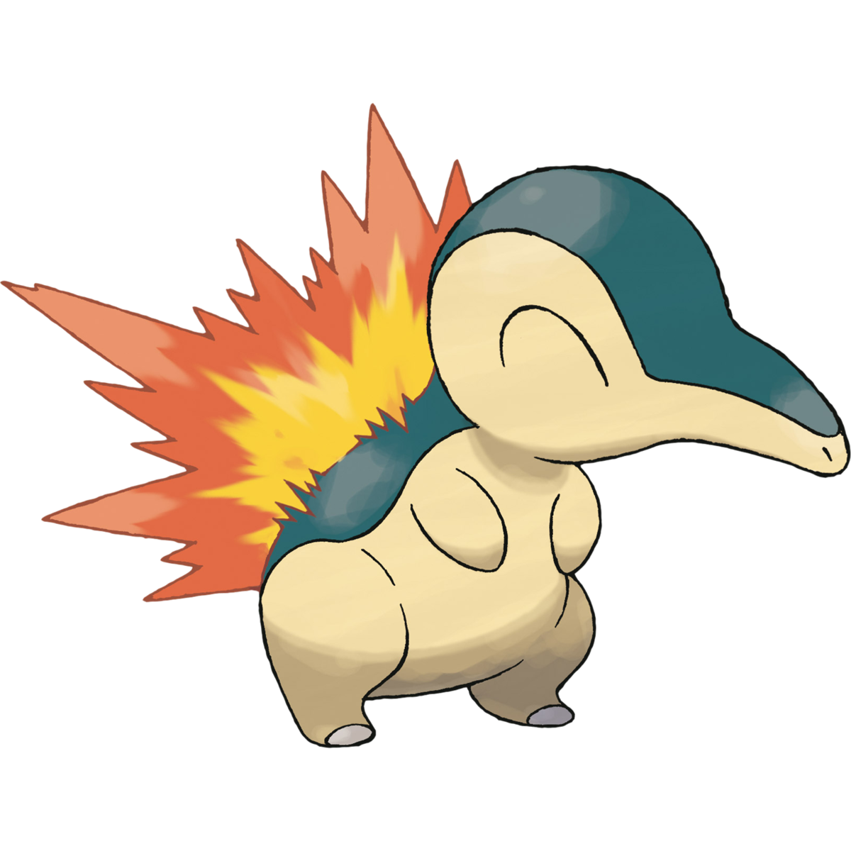
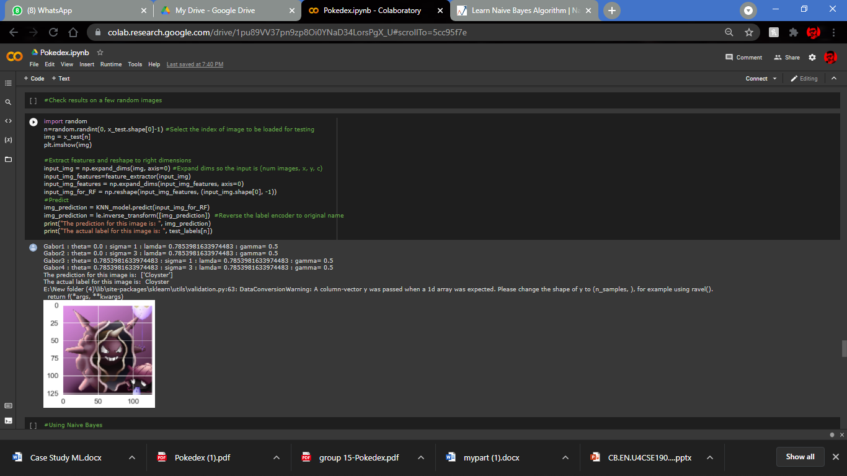
K N N (Validation)

Slide 13
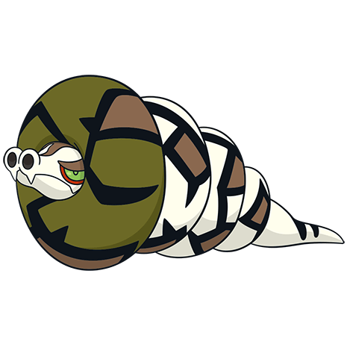
Naïve Bayes
Naive Bayes classifier assumes that the presence of a particular feature in a class is unrelated to the presence of any other feature.
Naive Bayes model is easy to build and particularly useful for very large data sets.
Bayes theorem provides a way of calculating posterior probability P(c|x) from P(c), P(x) and P(x|c)
This Photo by Unknown Author is licensed under CC BY-SA

Slide 14
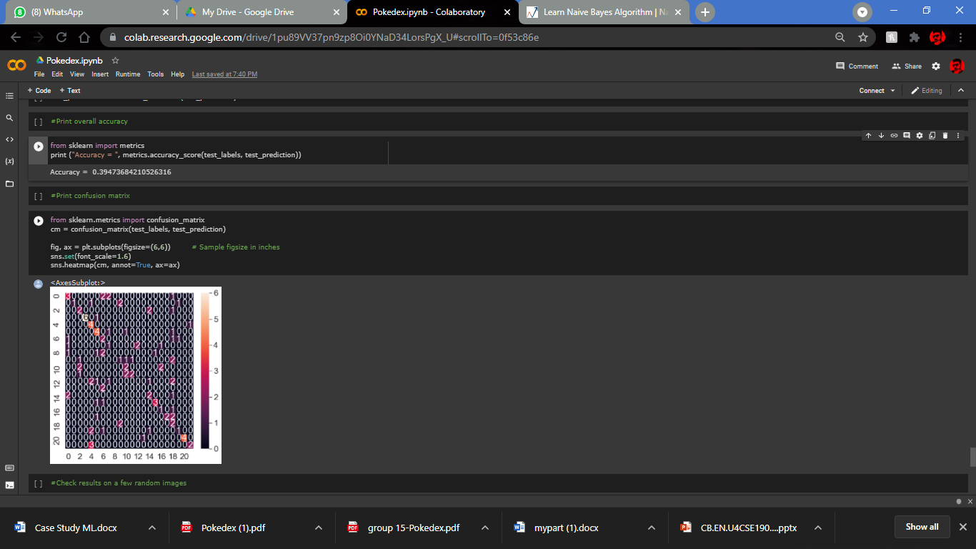
Naïve Bayes
Accuracy:
0.39473684210526316

Slide 15
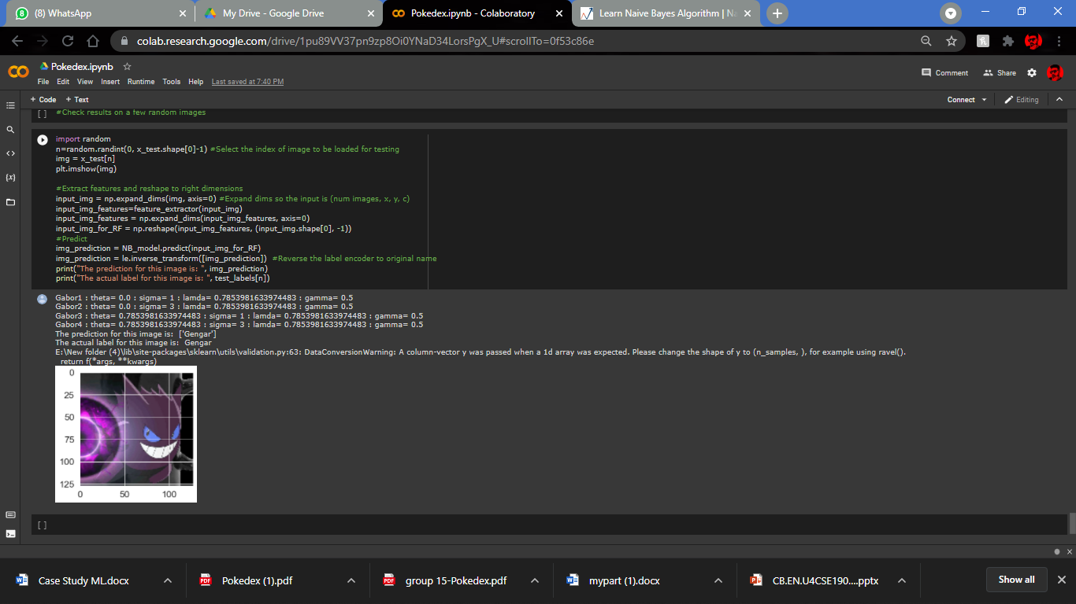
Naïve Bayes (Validation)

Slide 16

Conclusion
Random Forest
K N N
Naïve Bayes
From the above observation we found the accuracy of our trained model random forest as 0.6842105263157895
So it is most efficient model
We can clearly see in the validation the model correctly predicted Squirtle
We can still improve the accuracy by modifying the sigma , theta, lambda and gamma values
From the above observation we found the accuracy of our trained model KNN as 0.43859649122807015
It is a usable model
We can clearly see in the validation the model correctly predicted Cloyster
We can still improve the accuracy by modifying the sigma , theta, lambda and gamma values
From the above observation we found the accuracy of our trained model Naïve Bayes as 0.39473684210526316
It is a usable model
We can clearly see in the validation the model correctly predicted Gengar
We can still improve the accuracy by modifying the sigma , theta, lambda and gamma values

Slide 17
Still we can use SVM and Ada Boosting that also gives the accuracy similar to the models KNN and Naïve Bayes
SVM and decision trees will be explained by Suryanarayan
By: S.Vigneshwararaj
CB.EN.U4CSE19060

Slide 18
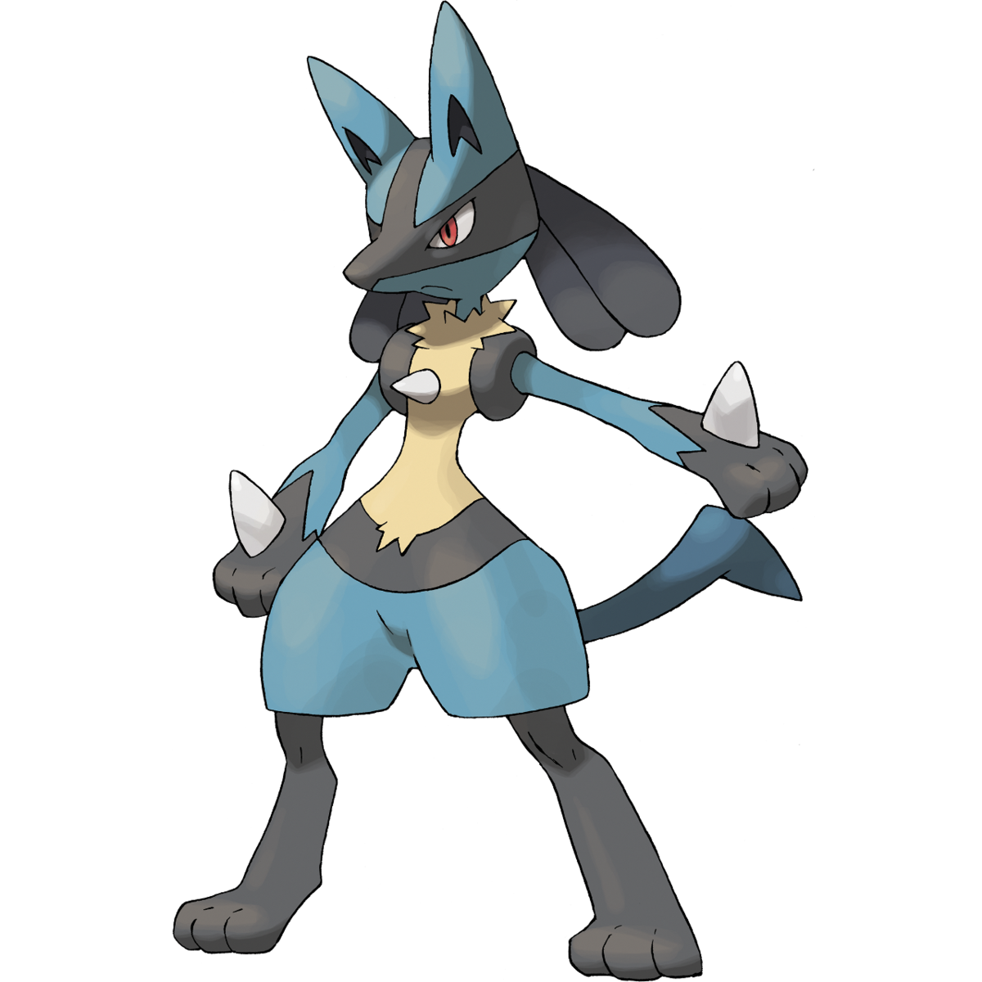
ML Project (SVM and Decision Tree)
By Suryanarayan.B

Slide 19
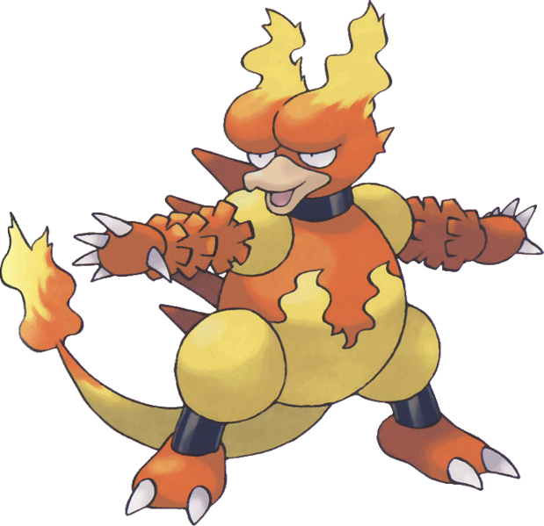

Decision Trees
Decision Tree is a Supervised learning technique that can be used for both classification and Regression problems, but mostly it is preferred for solving Classification problems. It is a tree-structured classifier, where internal nodes represent the features of a dataset, branches represent the decision rules and each leaf node represents the outcome.
In a Decision tree, there are two nodes, which are the Decision Node and Leaf Node. Decision nodes are used to make any decision and have multiple branches, whereas Leaf nodes are the output of those decisions and do not contain any further branches.

Slide 20
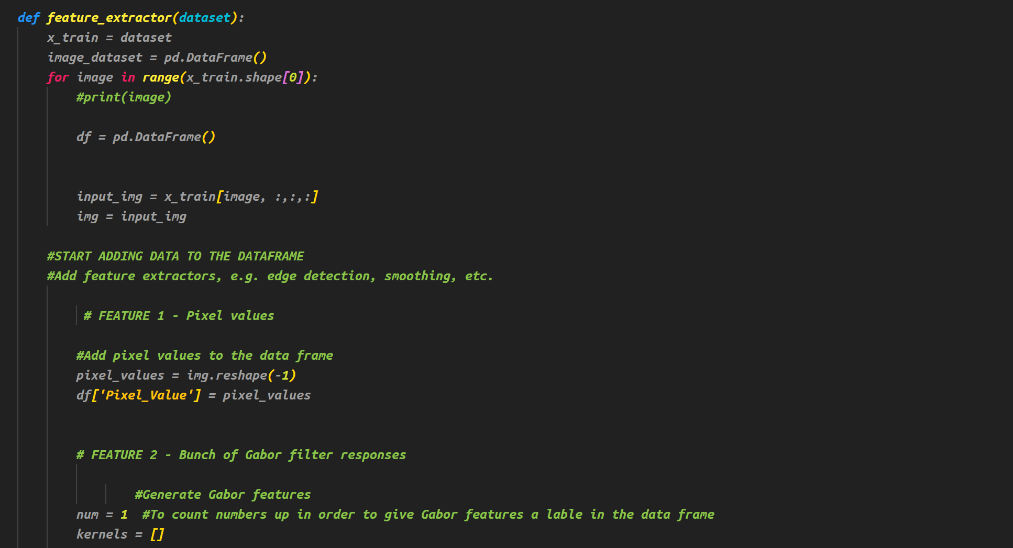
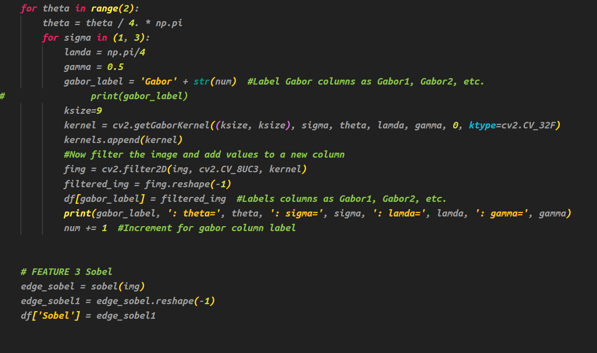
Image Preprocessing using Opencv
Here we use gaussian filter and
Sobal Edge detection for Image

Slide 21
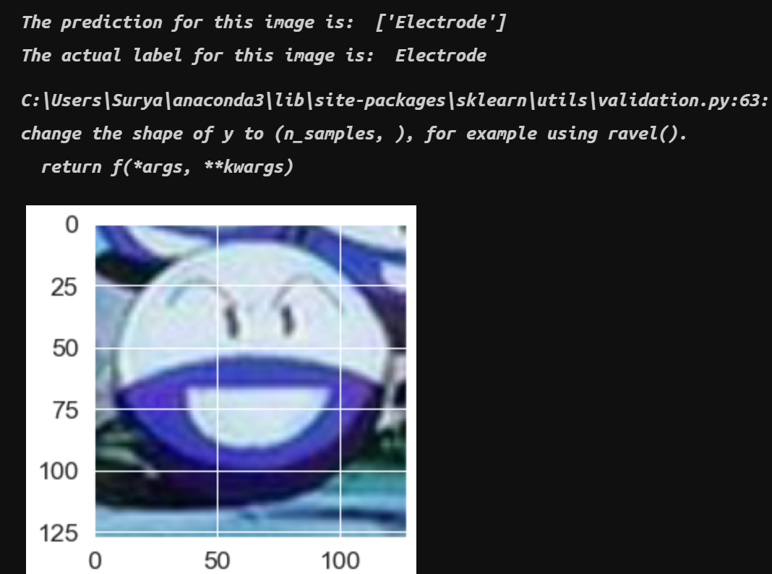

Accuracy
The Accuracy we got after the implementation is 23%
Predicted Image:
Decision trees are unstable, meaning that a small change in the data can lead to a large change in the structure of the optimal decision tree. They are often relatively inaccurate.
Due to this this isn’t an efficient algorithm for Image Identification

Slide 22
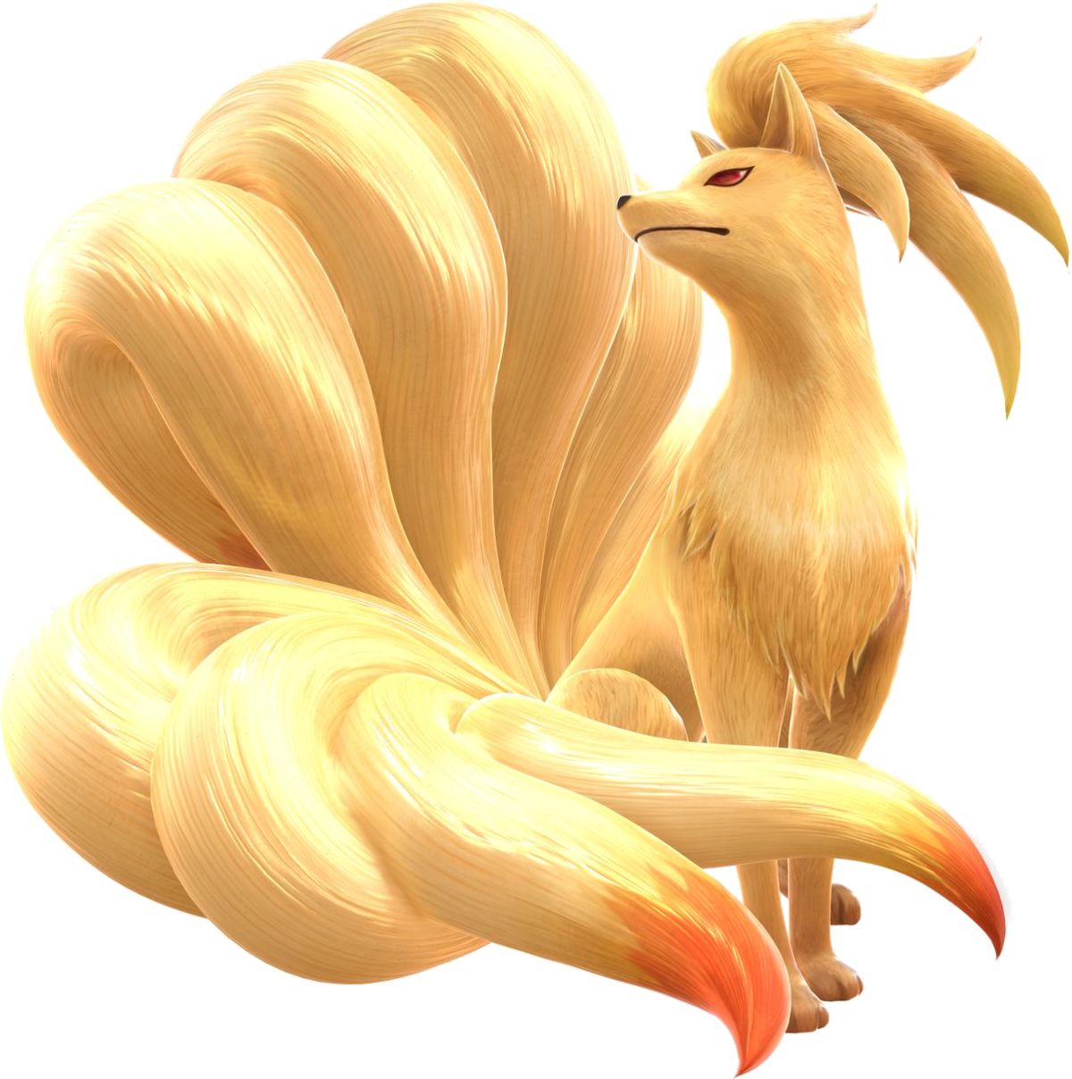

SVM(Support Vector Machine)
Support Vector Machine or SVM is one of the most popular Supervised Learning algorithms, which is used for Classification as well as Regression problems. However, primarily, it is used for Classification problems in Machine Learning.

Slide 23
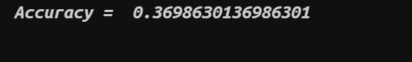
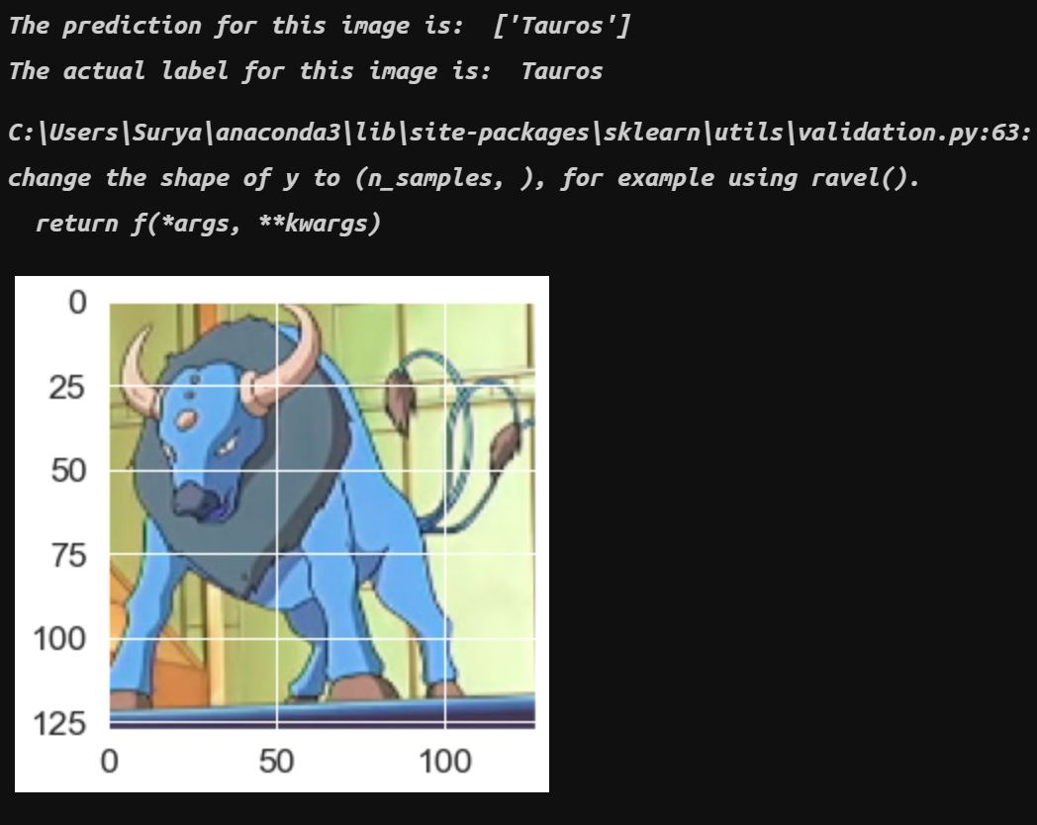
Using Classical Method
Accuracy:
Predicted Image:
In the classical method we use gaussian filter and Sobal edge detection to preprocess the image
The accuracy we get from SVM using sklearn is 36.98%
SVM can also be done using Tensorflow
Next slide explains about the implementation of SVM using tensorflow

Slide 24
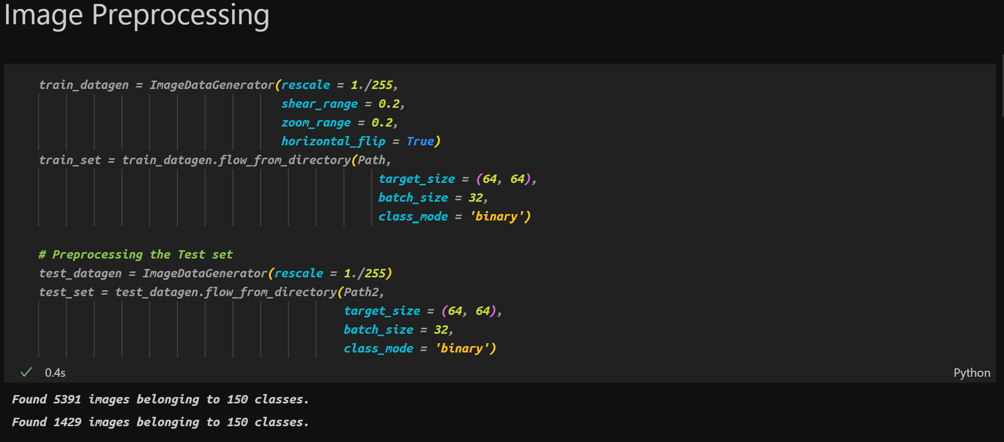
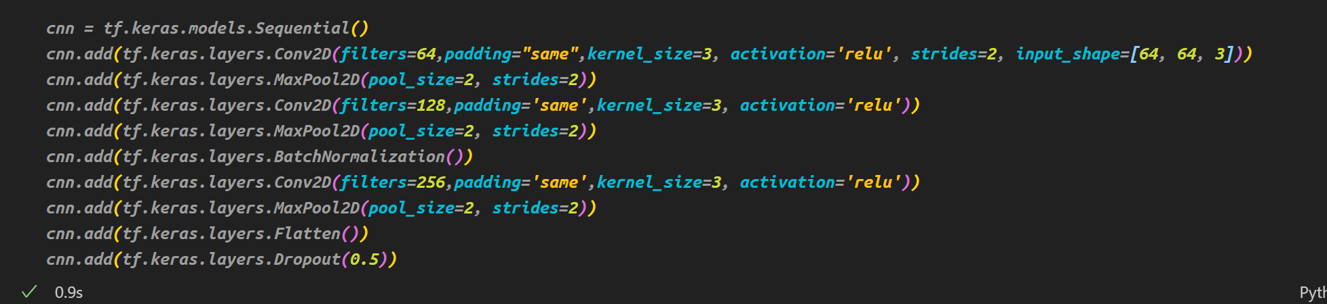
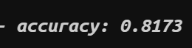
Using Advanced Method
We used Tensorflow to
Implement SVM and applied Feature Extraction and Dimensionality reduction
The accuracy obtained is 81.73%

Slide 25
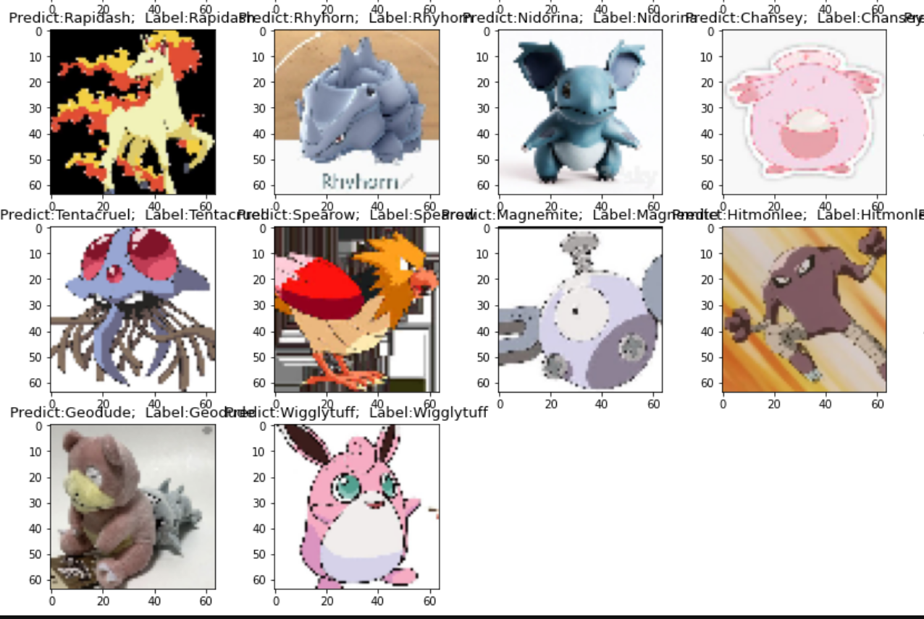
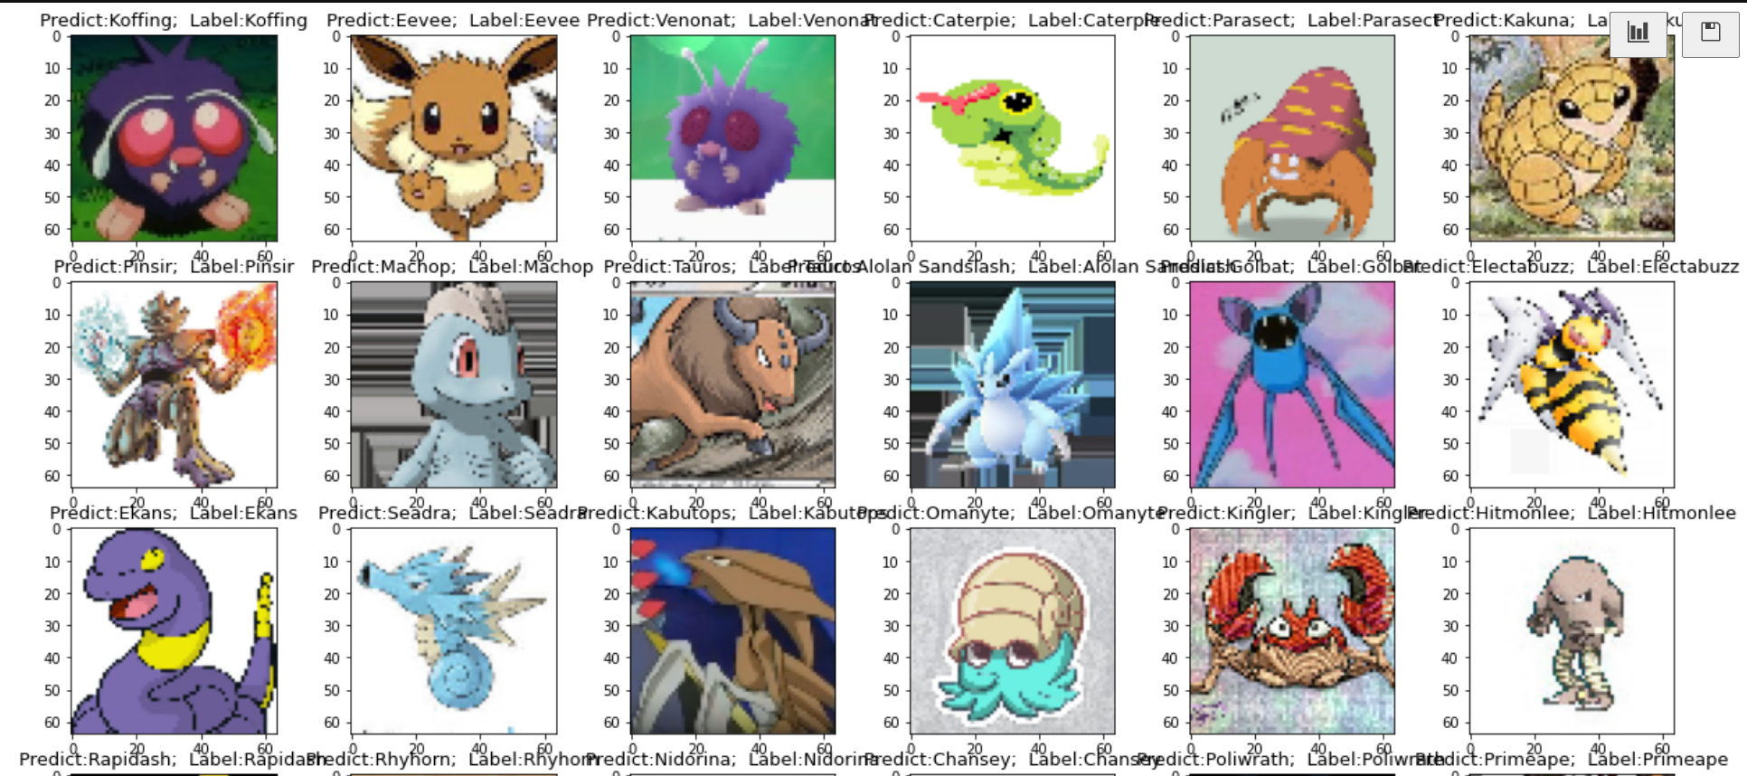
The Predicted Model

Slide 26
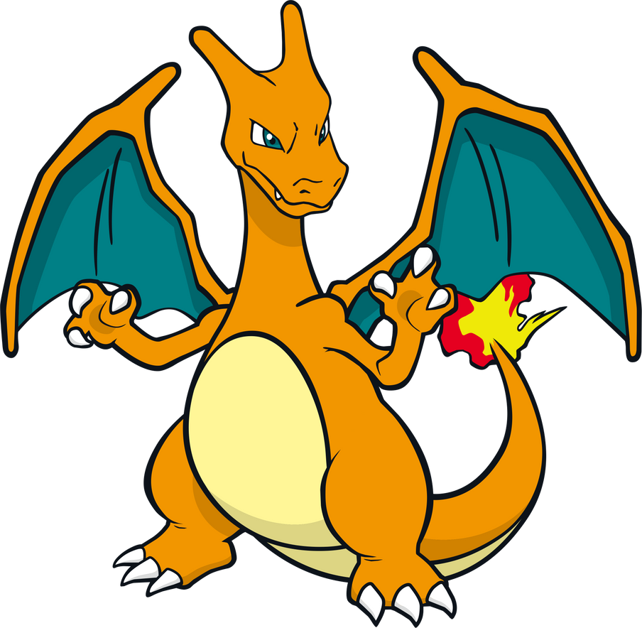
Conclusion
Comparing the two models we conclude that the model which is trained using Tensorflow and CNN not only gives a better accuracy score but also better prediction than the model which is trained through sklearn

Slide 27
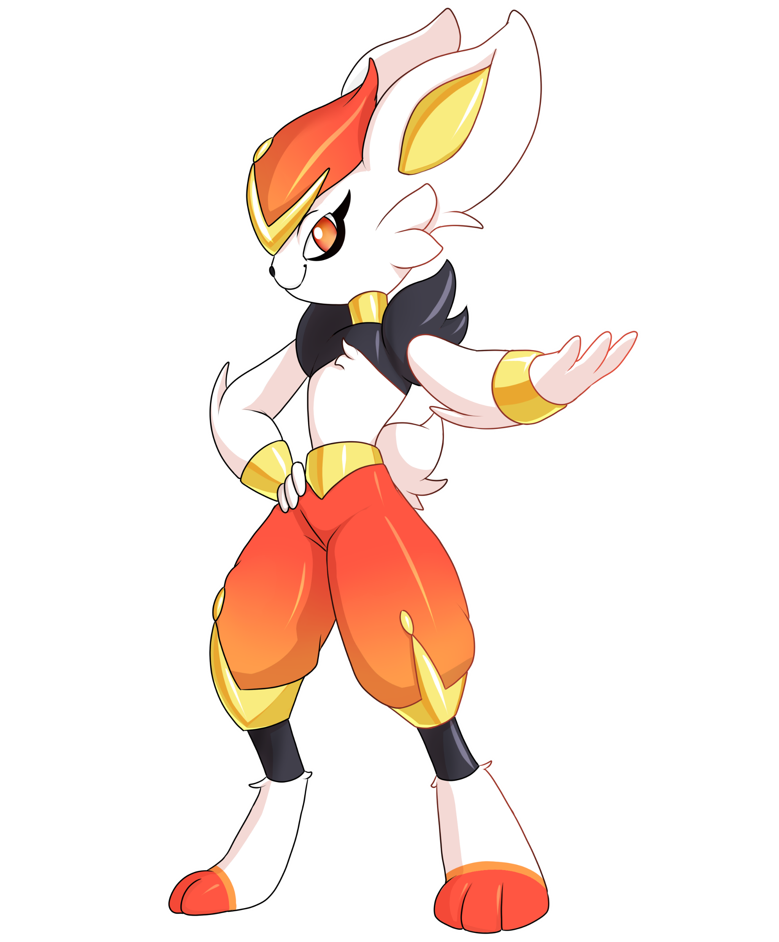
Adithya Varshan Bharathi Babu
Using neural networks

Slide 28
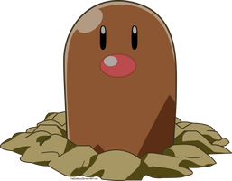
Custom cnn model:-
https://github.com/adhithya-varshan/pokeDex/blob/main/Custom%20CNN.ipynb

Slide 29
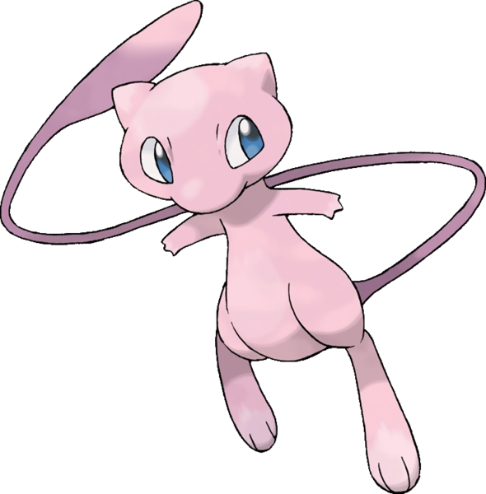
Model:-
model = tf.keras.models.Sequential()
model.add(tf.keras.layers.Conv2D(filters = 256 ,kernel_size = 3,activation= "relu",input_shape = [64,64,3]))
model.add(tf.keras.layers.MaxPool2D(pool_size=2,strides = 2))
model.add(tf.keras.layers.Conv2D(filters = 128 ,kernel_size = 3,activation= "relu"))
model.add(tf.keras.layers.MaxPool2D(pool_size=2,strides = 2))

Slide 30

Model cont..
model.add(tf.keras.layers.BatchNormalization())
model.add(tf.keras.layers.Conv2D(filters = 64 ,kernel_size = 3,activation= "relu"))
model.add(tf.keras.layers.MaxPool2D(pool_size=2,strides = 2))
model.add(tf.keras.layers.Flatten())
model.add(tf.keras.layers.Dropout(0.3))
model.add(tf.keras.layers.Dense(units = 512,activation = 'relu’))
model.add(tf.keras.layers.Dense(units = 256,activation = 'relu'))

Slide 31

Model Cont..
model.add(tf.keras.layers.Dense(units = 128,activation = 'relu'))
model.add(tf.keras.layers.Dense(len(classes),activation = 'softmax'))
model.compile(optimizer = 'adam',loss = 'categorical_crossentropy',metrics = ['accuracy'])
model.fit(training_Set,epochs = 20)

Slide 32
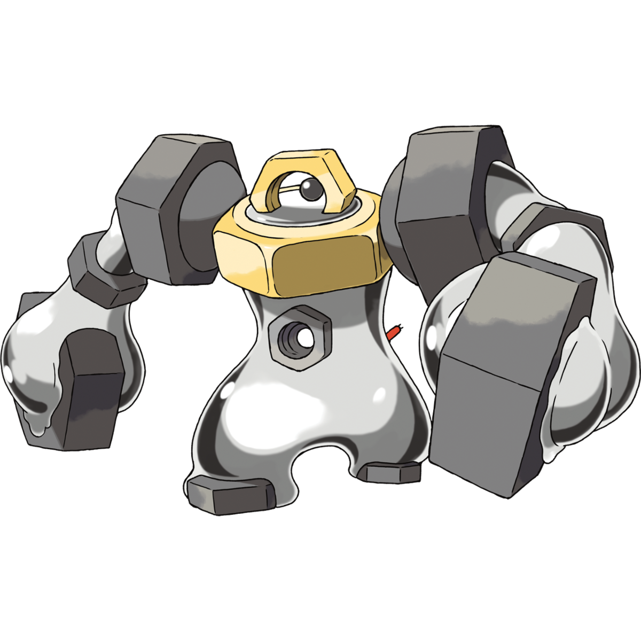
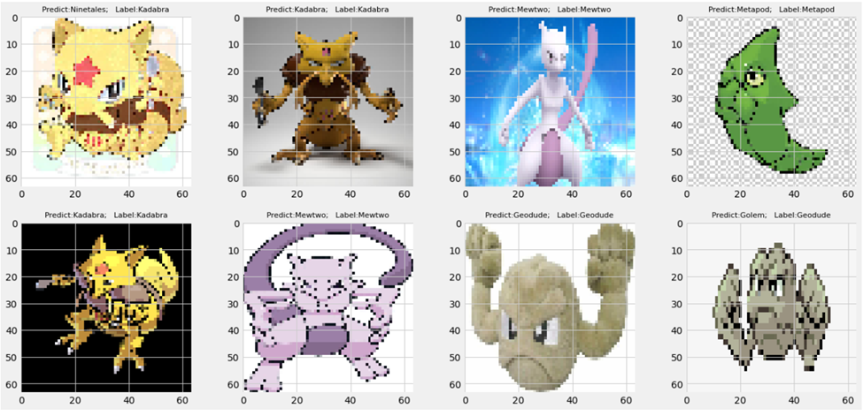
Predictions on new images:-

Slide 33

Xception
Xception was proposed by none other than François Chollet himself, the creator of the Keras library.
Xception is an extension of the Inception architecture which replaces the standard Inception modules with depth wise separable convolutions.
Xception sports the smallest weight serialization at only 91MB.
https://github.com/adhithya-varshan/pokeDex/blob/main/Xception%20(1).ipynb

Slide 34
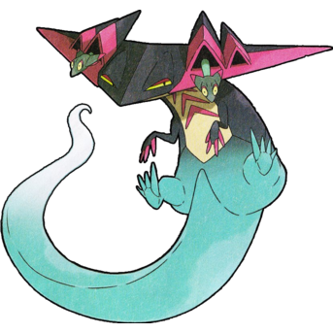
Model
base_model = tf.keras.applications.xception.Xception(weights = "imagenet", include_top = False)
avg = tf.keras.layers.GlobalAveragePooling2D()(base_model.output)
output = tf.keras.layers.Dense(150,activation = "softmax")(avg)
model = tf.keras.Model(inputs = base_model.input,outputs = output)
for layer in base_model.layers:
layer.trainable = False

Slide 35
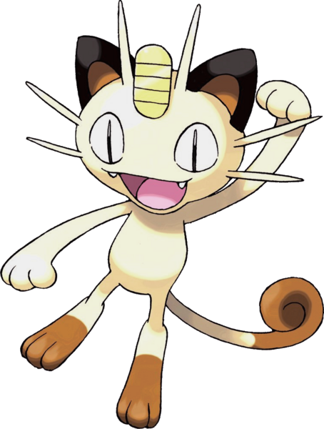
Model cont.…
optimizer = tf.keras.optimizers.SGD(learning_rate=0.01,momentum=0.9,name='SGD')
model.compile(loss = 'categorical_crossentropy',optimizer=optimizer,metrics=["accuracy"])
hist = model.fit(training_Set,epochs = 15,validation_data= test_Set)
for layer in base_model.layers:
layer.trainable = True
optimizer = tf.keras.optimizers.SGD(learning_rate=0.001,momentum=0.9,name='SGD’)
model.compile(loss = 'categorical_crossentropy',optimizer=optimizer,metrics=["accuracy"])
hist = model.fit(training_Set,epochs = 15,validation_data= test_Set)

Slide 36

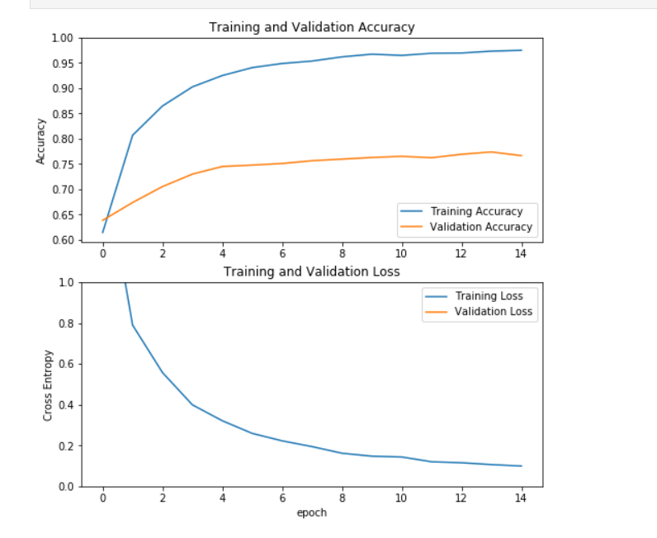
Model
Training and Validation Accuracy
Training and Validation Loss

Slide 37
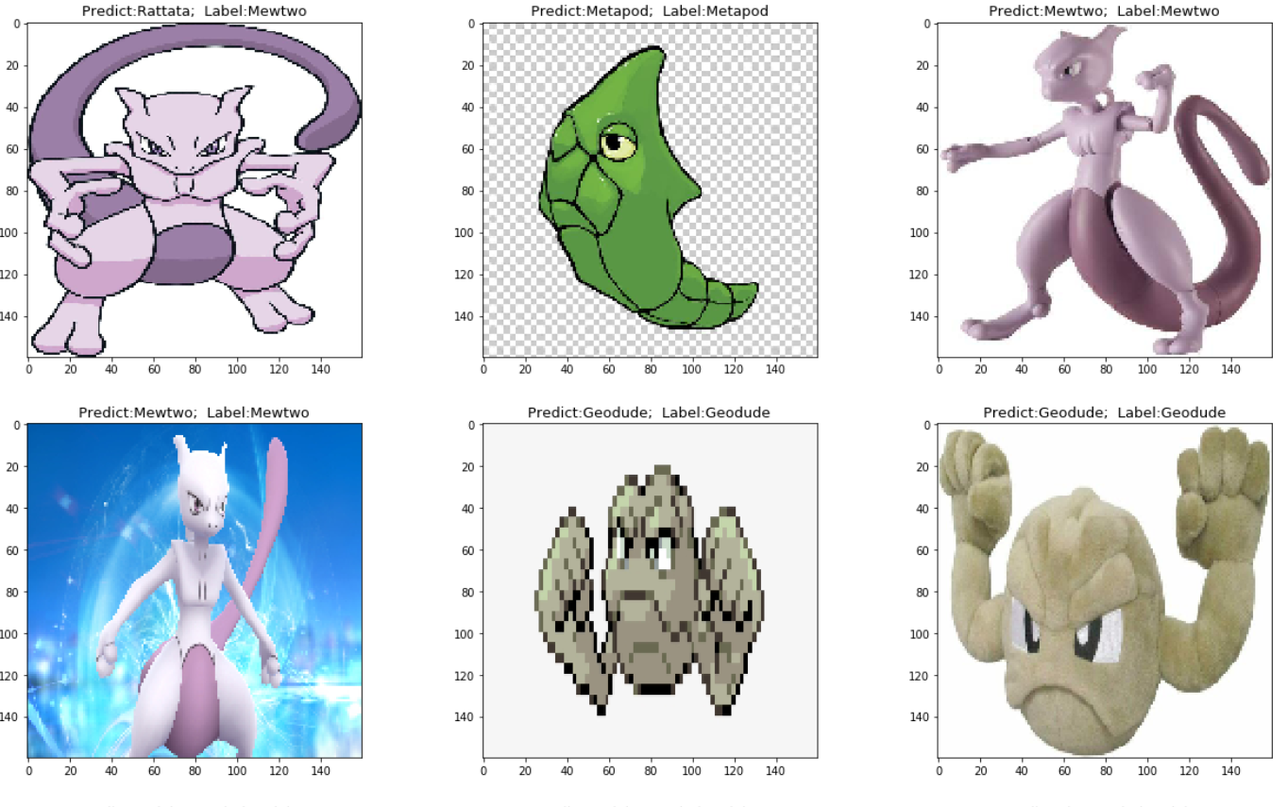
Predictions

Slide 38
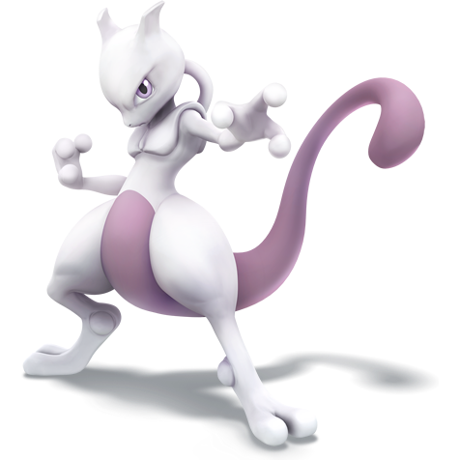
Thank You

